Slide 1


XPLORA INNOVATHON 2026
HELPING HAND
DIGITAL DONATION PLATFORM
“CONNECTING PEOPLE WHO NEED HELP WITH THOSE WHO CAN HELP”
XPLORA INNOVATHON 2026
TEAM – 25 ( CORE CARES )
MEMBERS – JITENDRA KUMAR NAYAK
SUPRIT PRASAD NAYAK
JYOTI PRAKASH ARUKHA
PRABHUPADA PANDA

Slide 2
XPLORA INNOVATHON 2026
PROBLEM STATEMENT
Content should cover:
PROBLEM-There are many people who need help and also there are many people who wants to help them but they can’t recognize each-other So they donate it to a NGOs but NGOs may not use it efficiently .our project makes them connect directly .
USER WHO AFFECTED-Beggar’s , poor people are affected by this problem not only these people but also many middle class people are also need help.
WHY ITS IMPORTANT- Control wastage , Reduce polluction, help needy people, and save environment.
CURRENT ISSUES – Now a day’s Application are very complex and confusing for people . A non-skilled people not able to use it . So our project make it more easier and attractive by which everyone can access it and use it very efficiently.

Slide 3
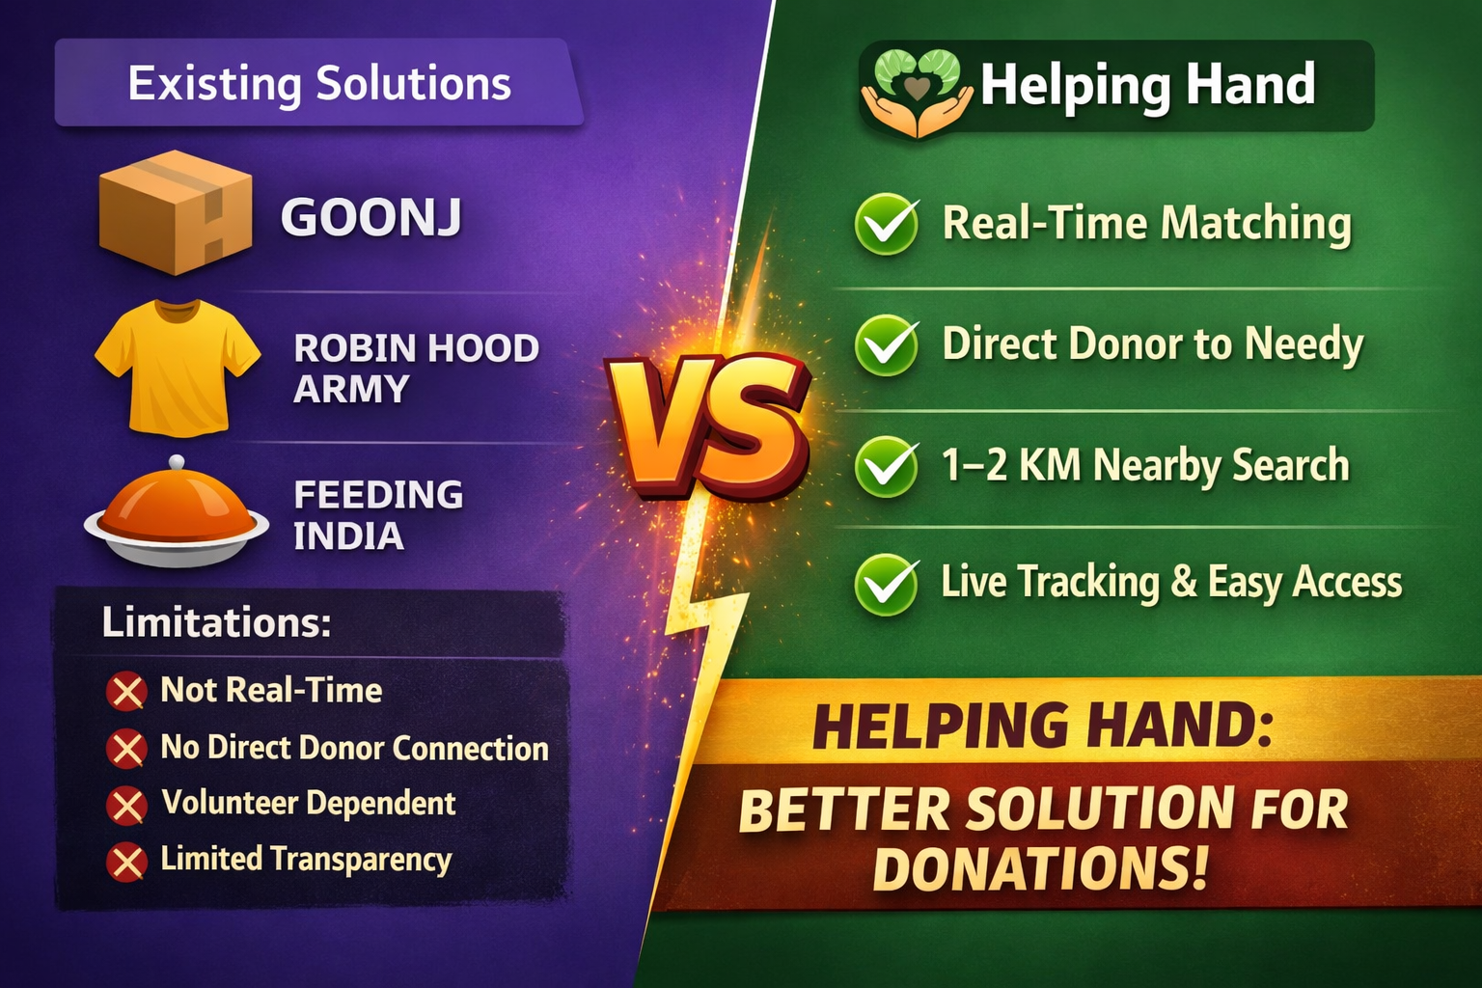
XPLORA INNOVATHON 2026
SOLUTION ALREADY EXIST AND THEIR LIMITATIONS
How Helping Hand Solves These Problems
✅ Real-Time Matching
Instantly shows nearby food and clothes donations within 1–2 km radius.
✅ Direct Donor to Needy Connection
No middle NGO delay. Direct reservation and contact details available.
✅ Hyperlocal Search
Focused only on nearby area to reduce travel time.
✅ Live Location Tracking
Users can see exact donor location on map.
✅ Quick Reservation System
Reserve food immediately before someone else takes it.
✅ Transparent Details
Donor provides phone number, address, and donation details.

Slide 4
XPLORA INNOVATHON 2026
How Does It Work?
Step 1: Donor registers and fills donation form
Food/clothes details
Quantity
Address
Phone number
Live location enabled
Step 2: Volunteer/mediator searches nearby donations
App filters within 1–2 km radius
Available donations are shown on map
Step 3: Reservation
User reserves donation
Donor contact details are visible
Step 4: Collection
Needy person goes to donor location
Donation is successfully delivered
Why It Is Better Than Existing Solutions?
✅ Real-time availability ✅ Hyperlocal (1–2 km) instant search ✅ Direct donor-to-needy connection ✅ No dependency on large NGO systems ✅ Faster response time ✅ Increased transparency ✅ Simple and easy to use

Slide 5
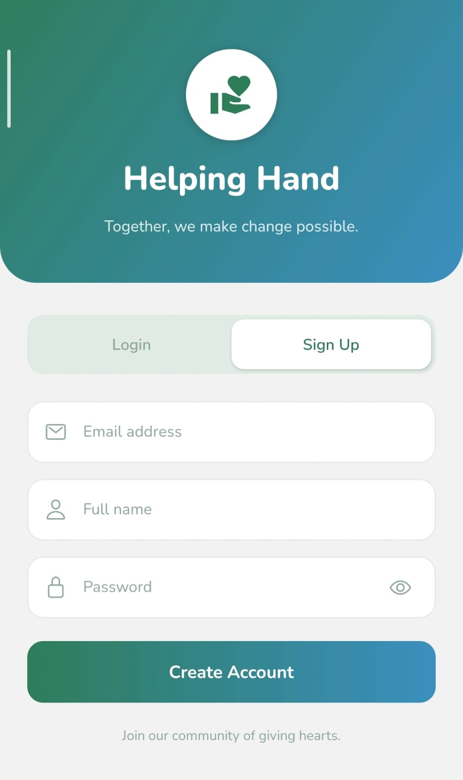
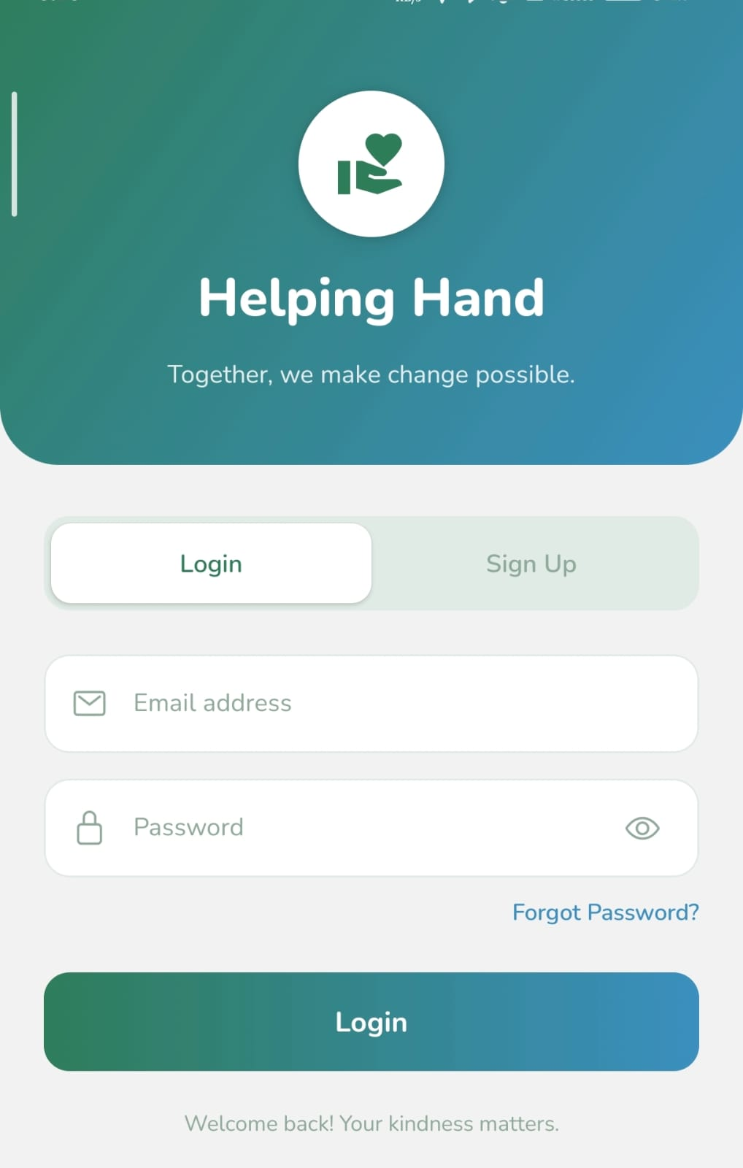
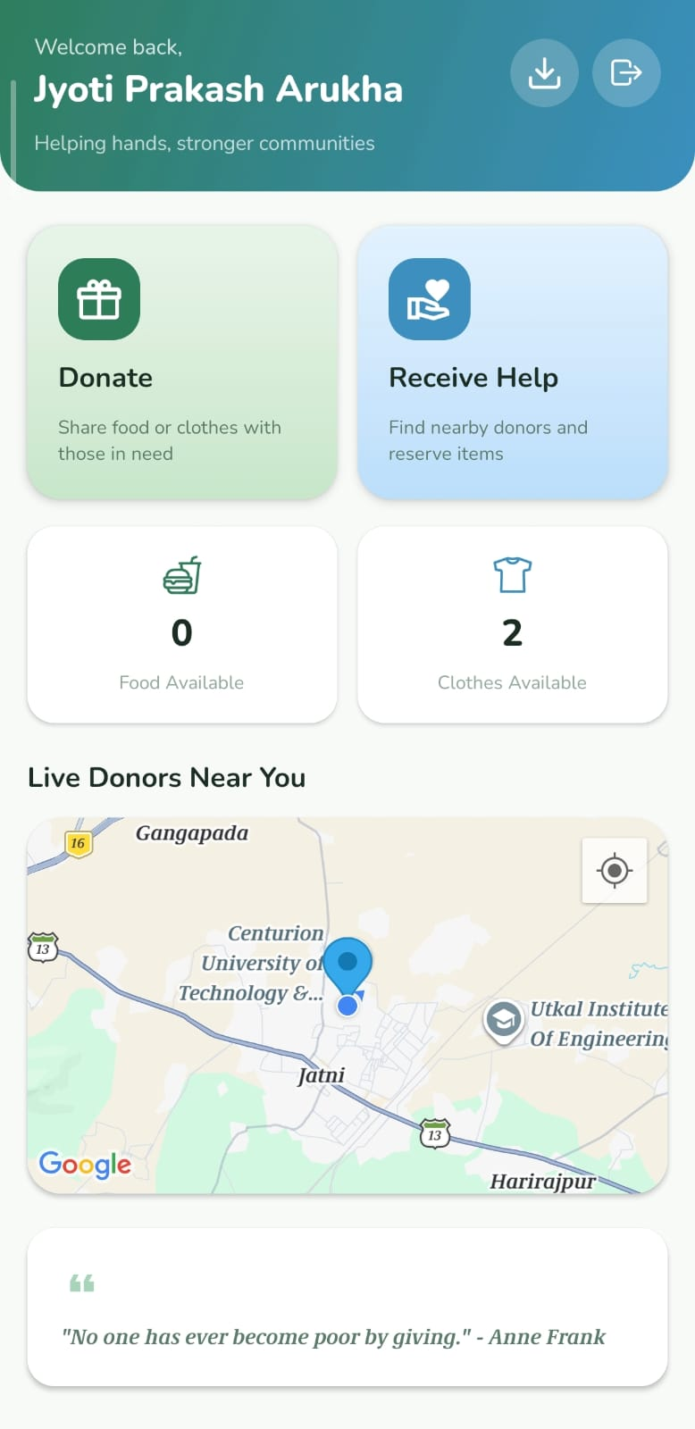
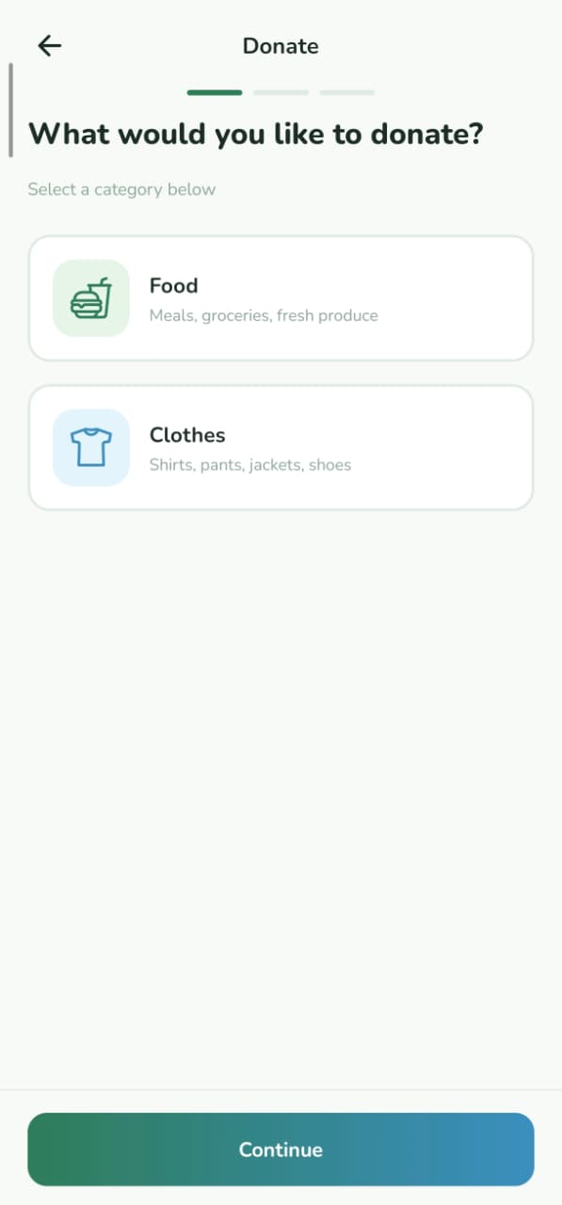
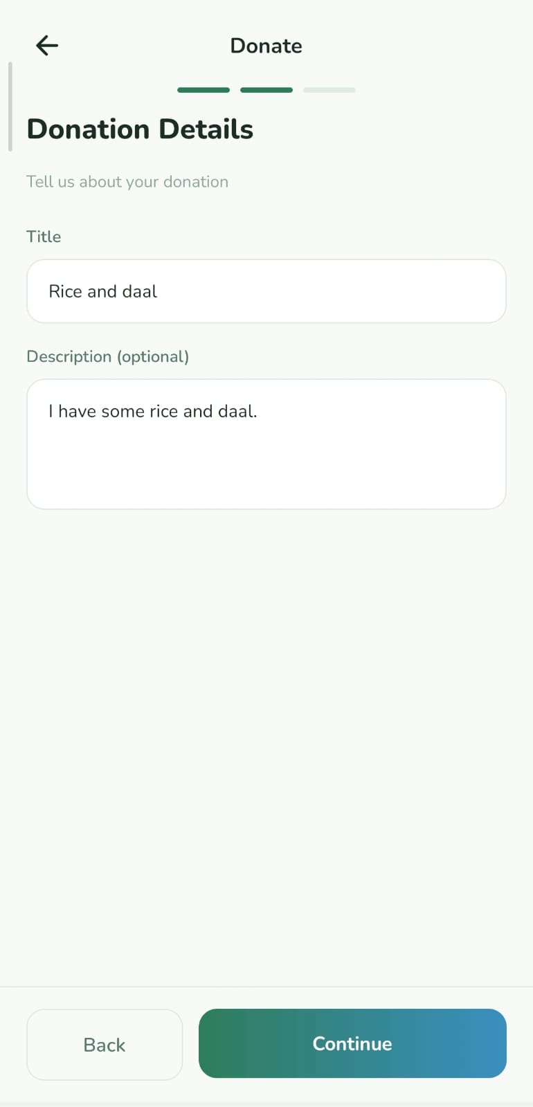
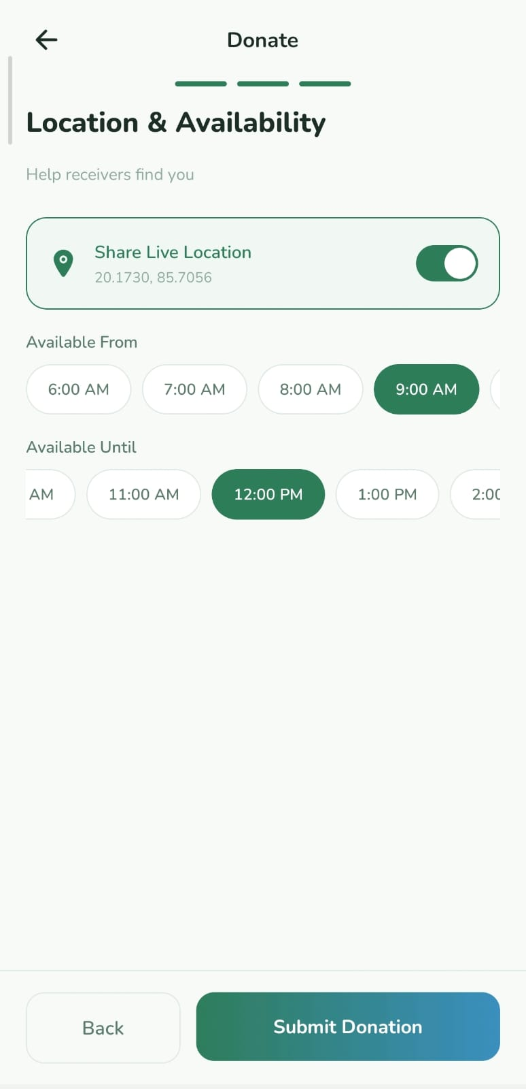
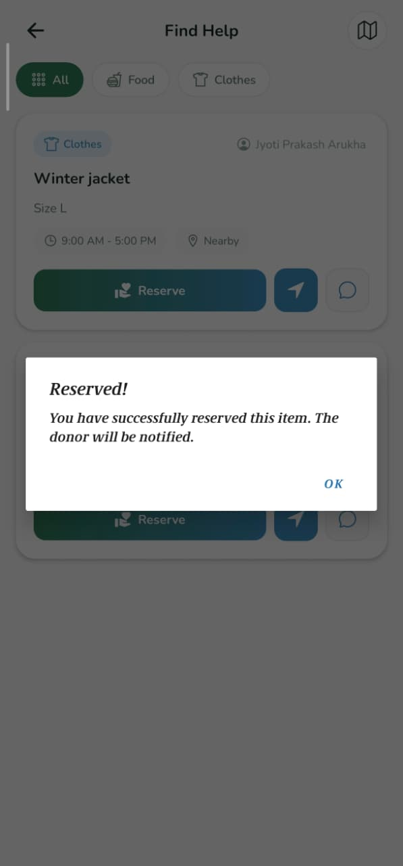
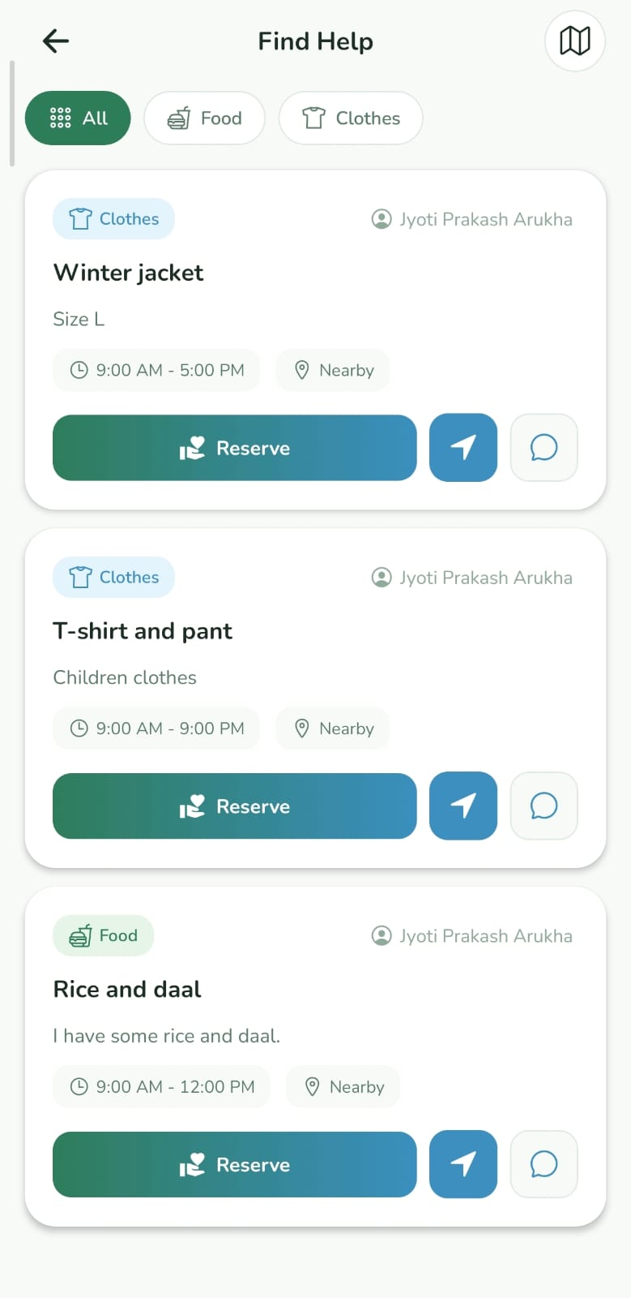
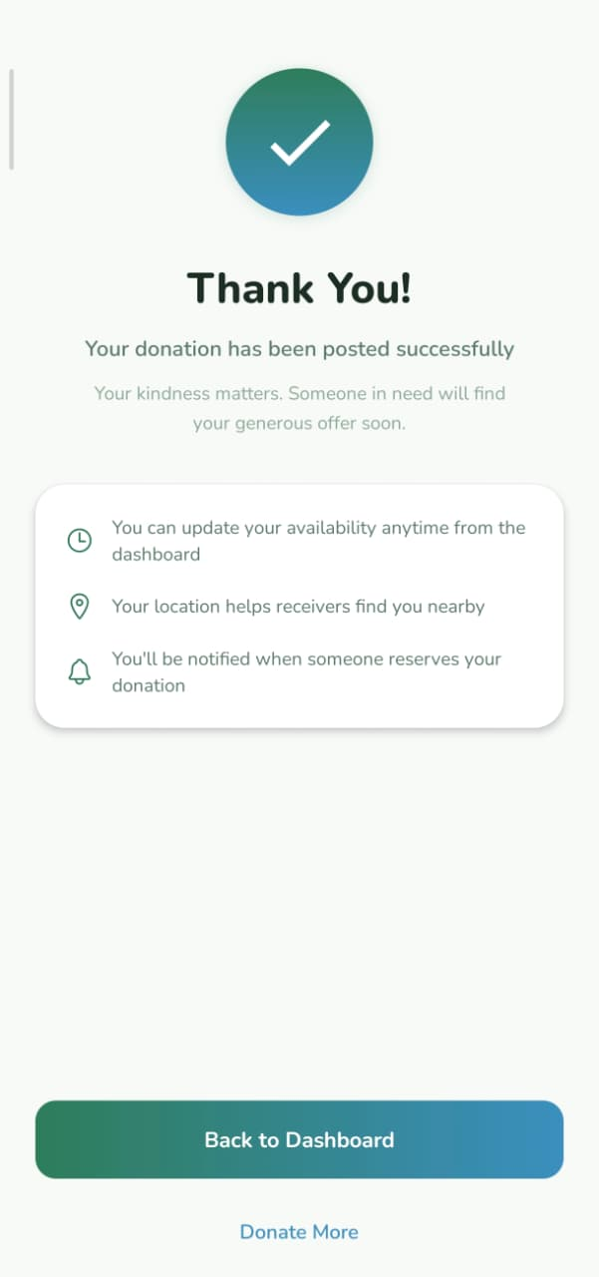
XPLORA INNOVATHON 2026
Live Demo Flow
>
>
>
>
>
>
Application Flow
1️⃣ Donor registers and submits food/clothes details with location.
2️⃣ System displays nearby donations within 1–2 km radius.
3️⃣ Volunteer/mediator reserves the available donation.
4️⃣ Donor details and live location are shown.
5️⃣ Needy person collects the donation successfully.
<
<

Slide 6
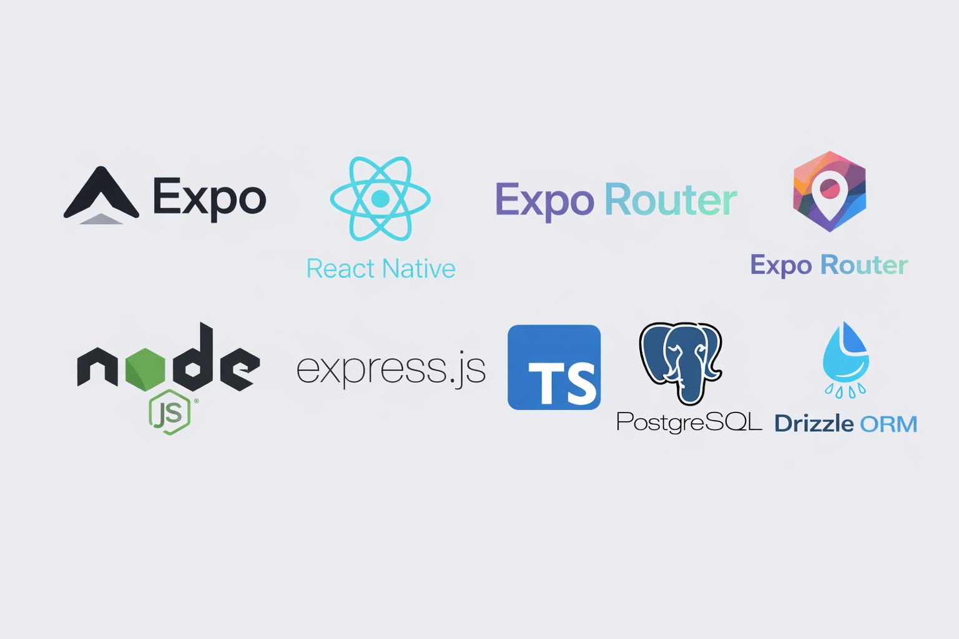
XPLORA INNOVATHON 2026
Technology Use
🎨 Frontend
Expo (React Native)
Expo Router (Navigation)
React Query (Data fetching)
Expo SDK 54
Expo Libraries
👉 Used to build fast and smooth mobile application.
⚙ Backend
Node.js
Express.js
Written in TypeScript
👉 Handles API requests, reservation system, and user management.
🗄 Database
PostgreSQL
Drizzle ORM
👉 Stores donor details, location data, and reservation information securely.

Slide 7
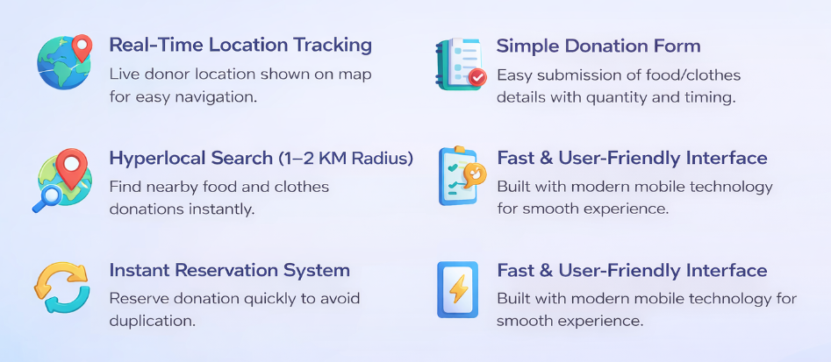
XPLORA INNOVATHON 2026
Key Features

Slide 8
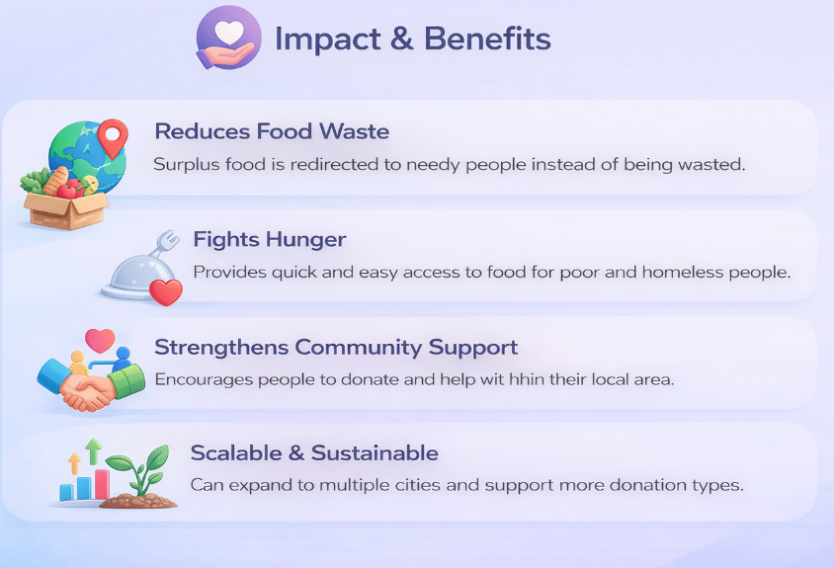
XPLORA INNOVATHON 2026

Slide 9
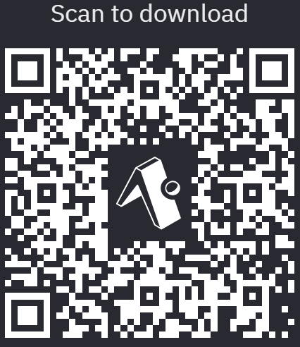
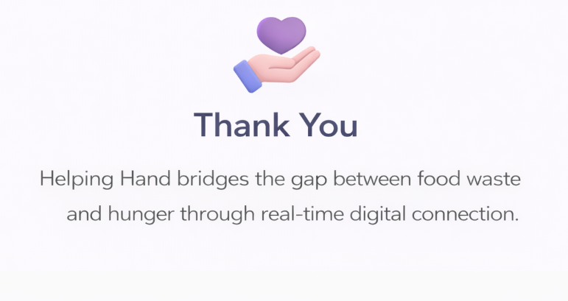
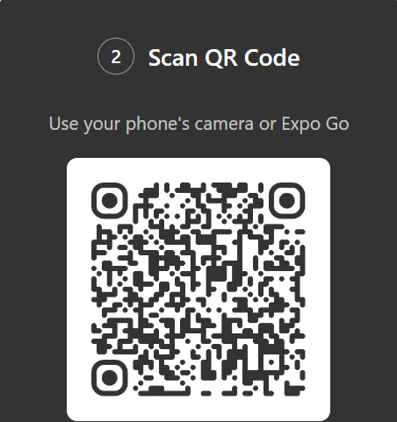
XPLORA INNOVATHON 2026
You can access our project
Through this app

